Slide 1
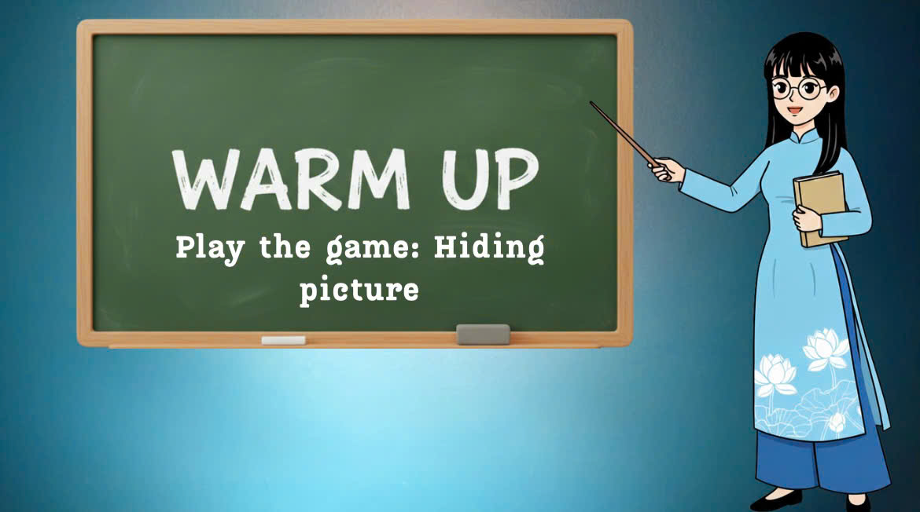

Slide 2

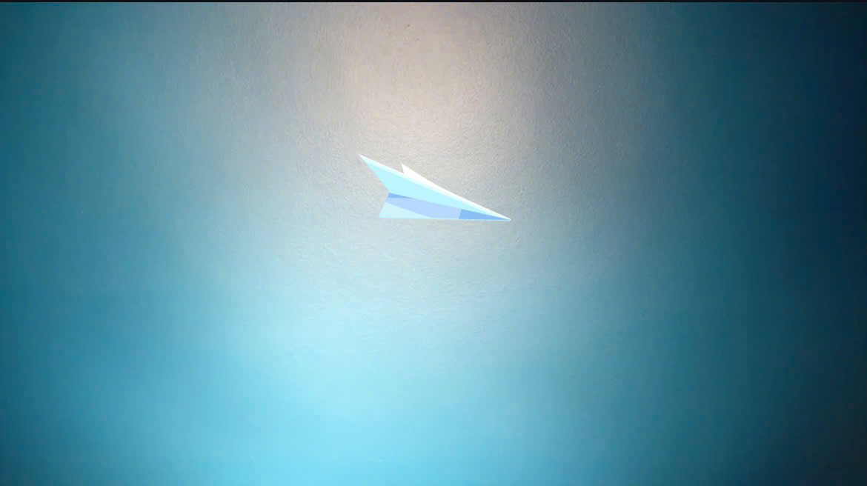
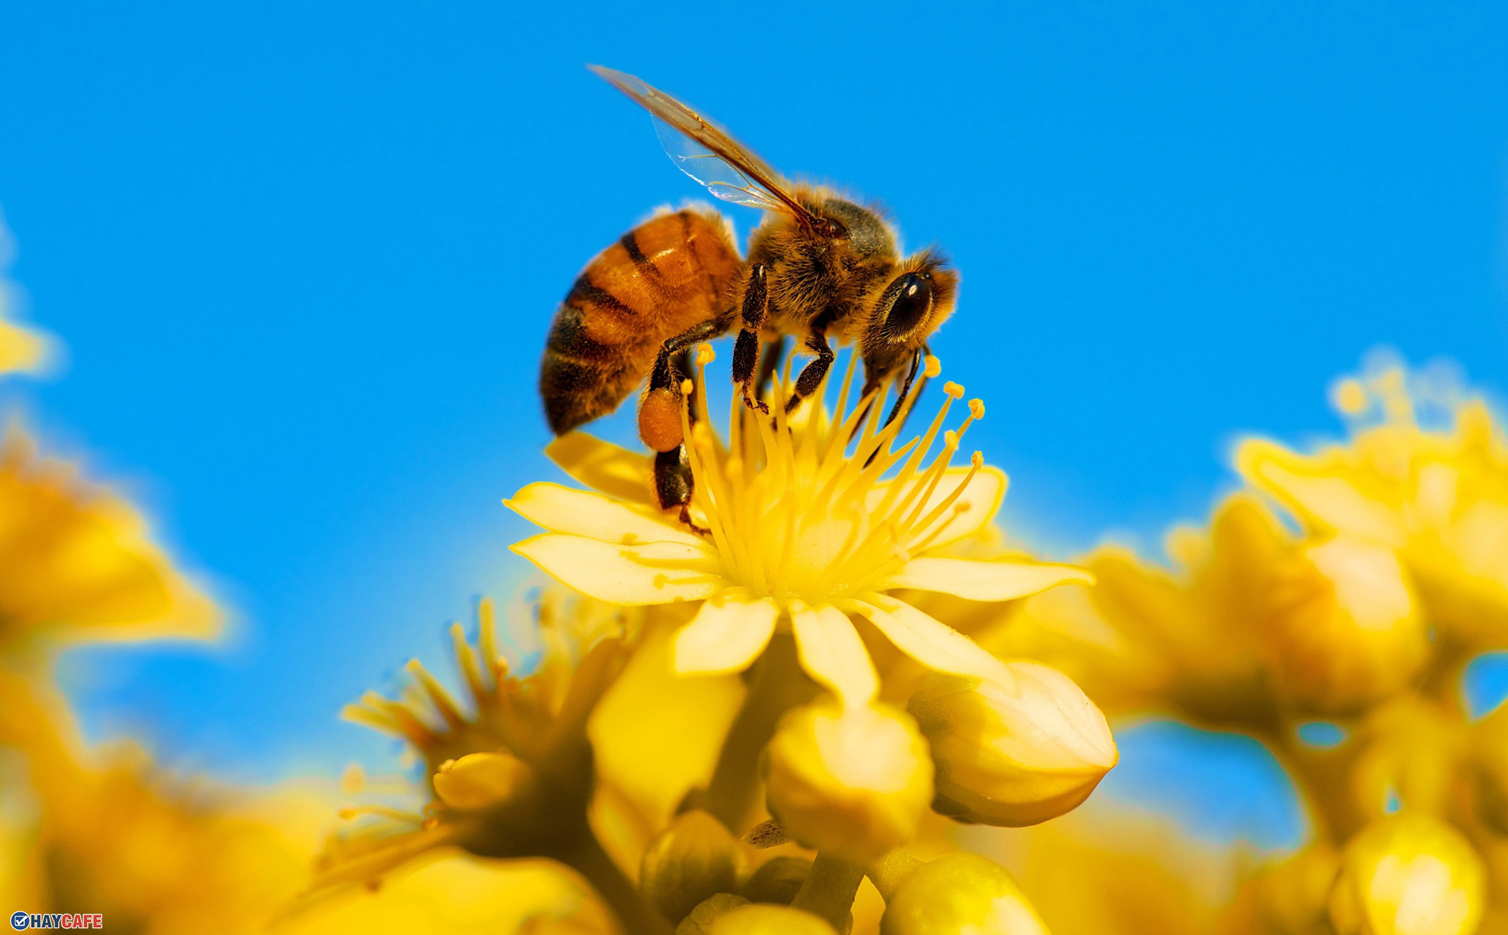
WHAT ANIMAL CAN YOU SEE IN THE PICTURE?

Slide 3
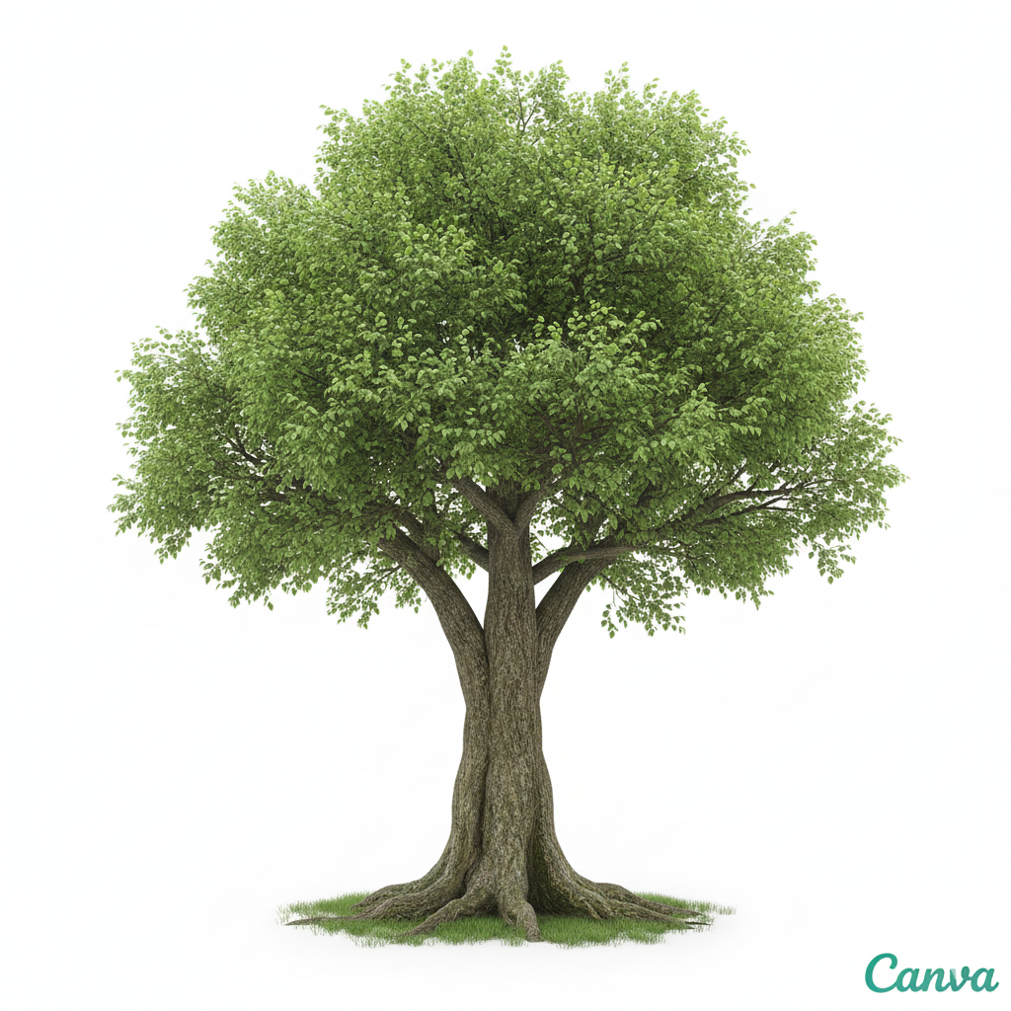
Would you like __________ (visit) the animal shelter this Friday?
to visit

Slide 4
to put out
Remember _________ (put out) the campfire before leaving the campsite.

Slide 5
taking
We enjoyed _________ (take) part in the clean-up day

Slide 6
Tourists need to stop _________ (throw) rubbish in the parks and beaches in our area.
throwing

Slide 7
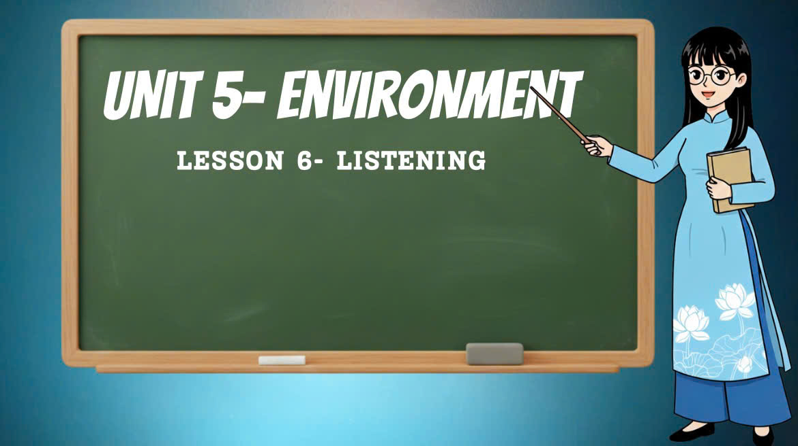

Slide 8

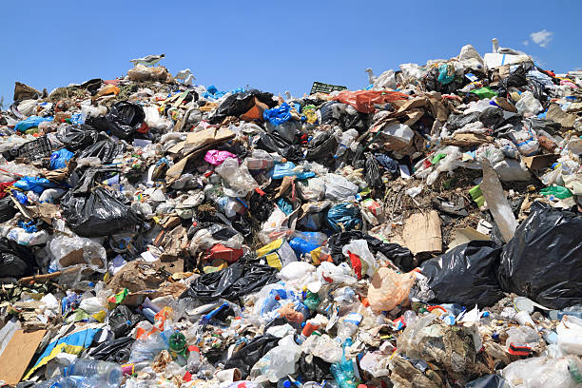
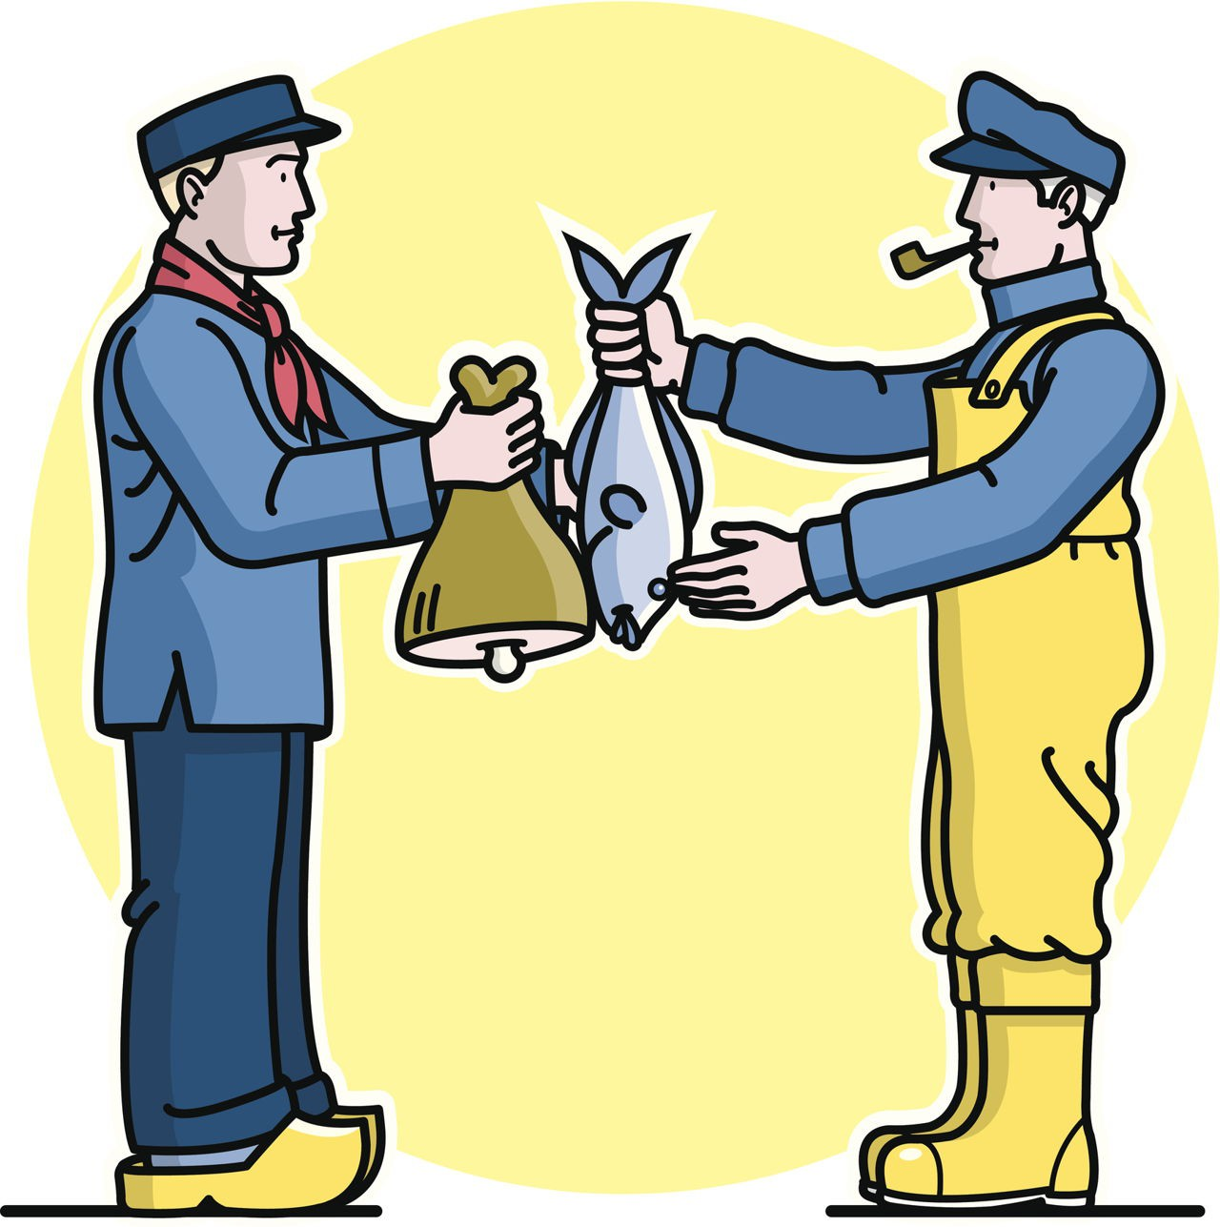
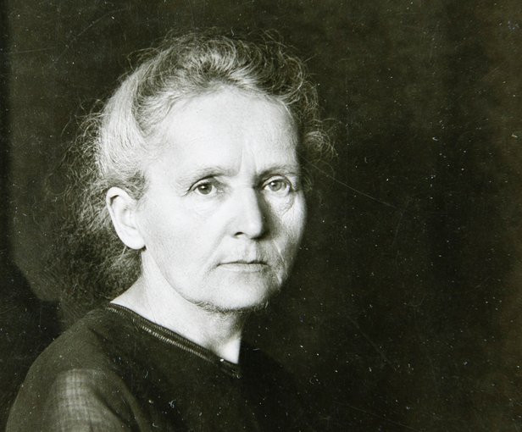

VOCABULARY
inspire (v) /ɪnˈspaɪər/
truyền cảm hứng
get inspired (phr)/ɡet ɪnˈspaɪəd/
được truyền cảm hứng
landfill (n) /ˈlænd.fɪl/
bãi rác
Pre-listening
swap (v) /swɒp/
trao đổi, hoán đổi
turn off (phr) /tɜːn ɒf /
tắt đi
turn on (phr) /tɜːn ɒn/
bật lên

Slide 9
True/False statements
Read the sentences and underline the key words.
Be careful with sentences that contain negatives.
For a sentence to be True, every part must be correct.

Slide 10
You are going to listen to an interview with Ruby and Jessica. Read the sentences (1–4) and underline the key words.
1. Ruby and Jessica got inspired by an environmental movement. ____
2. Bees are in danger because of climate change. _____
3. Ruby and Jessie’s first project was at their own school. _____
4. The main focus of Ruby and Jessie’s work now is on building Bee Gardens. _____

Slide 11

Now listen to the interview and decide if each of the statements (1–4) is T (True) or F (False).
1. Ruby and Jessica got inspired by an environmental movement. ____
2. Bees are in danger because of climate change. _____
3. Ruby and Jessie’s first project was at their own school. _____
4. The main focus of Ruby and Jessie’s work now is on building Bee Gardens. _____
F
T
T
F

Slide 12
Predicting content
Read the questions and possible answers.
Think of who the speakers are, where they are and what you expect the recording will be about.
This will help you do the task.

Slide 13

Listen to the dialogues. For each question (1–4), choose the correct answer (A, B or C).
1. You will hear two friends talking. What does the boy offer to help Kate do?
A. design the cards B. find recycled cards C. send the cards
2. You will hear a teacher talking to a student. The student is going to _______ .
A. build a wildlife shelter B. plant a wildlife garden C. organise a fundraising event
3. You will hear two friends talking. What is the girl planning to do with the glass jars?
A. recycle them B. reuse them C. put them in landfill
4. You will hear a girl talking to her mother. The girl tells her mum she’s going to _______ .
give her clothes to her sister
B. donate her clothes to charity
C. swap her clothes with her friends

Slide 14

Read the questions and the possible answers in Exercise 4. Which dialogue(s) take(s) place ...
– at home? ______
– in a shop? ______
– at school? ______

Slide 15
Listen to the dialogues. For each question (1–4), choose the correct answer (A, B or C).
1. You will hear two friends talking. What does the boy offer to help Kate do?
A. design the cards B. find recycled cards C. send the cards
2. You will hear a teacher talking to a student. The student is going to _______ .
A. build a wildlife shelter B. plant a wildlife garden C. organise a fundraising event
3. You will hear two friends talking. What is the girl planning to do with the glass jars?
A. recycle them B. reuse them C. put them in landfill
4. You will hear a girl talking to her mother. The girl tells her mum she’s going to _______ .
A. give her clothes to her sister B. donate her clothes to charity
C. swap her clothes with her friends

Slide 16
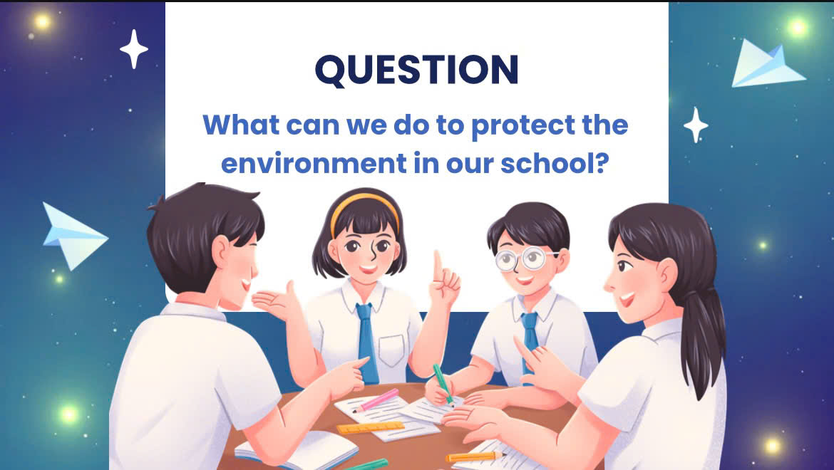

Slide 17
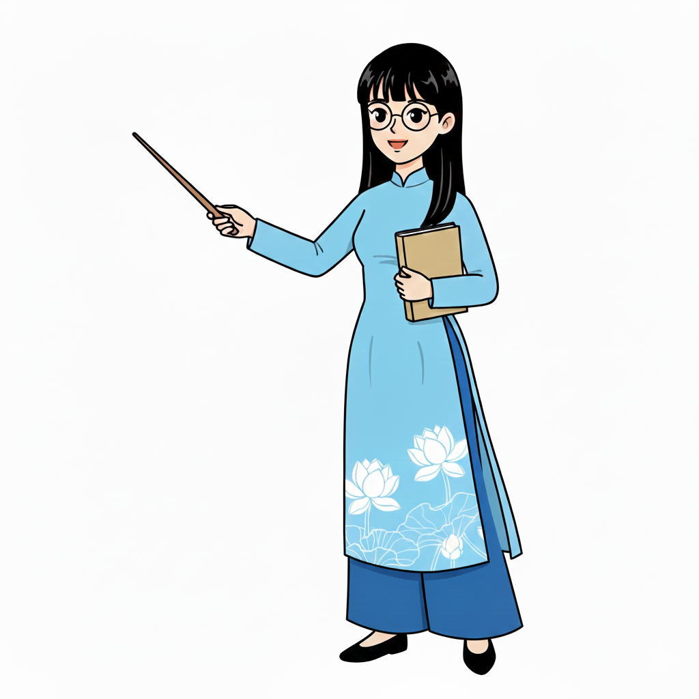

Today’s lesson
Vocabulary: inspire, landfill, swap, turn on, turn off
Listening: for specific information
(using listening strategies for True/False statements & multiple choice)

Slide 18
Homework
Learn all new words by heart.
Prepare the next lesson: 5d Speaking (page 63).

Slide 19

Stay positive and have a happy day!
See you in the next lesson.

Slide 20
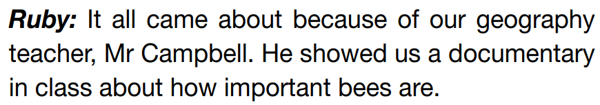
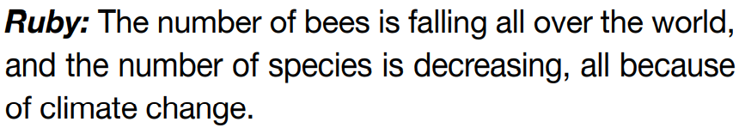
Listen again and answer the questions.
Extra listening
1. Who is Mr Campbell?
Ruby and Jessie’s geography teacher
2. What is the documentary about?
How important bees are
3. What’s happening to the number of bees all over the world?
It’s falling.
4. How about the number of species?
It’s decreasing.

Slide 21
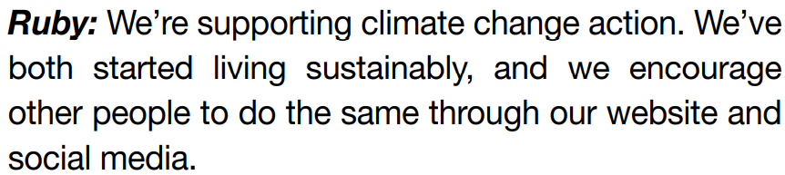
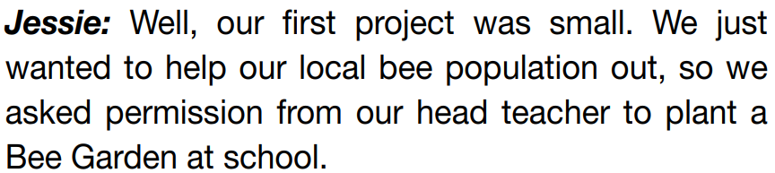

Listen again and answer the questions.
Extra listening
5. What was the purpose of Ruby and Jessie’s first project?
To help their local bee population out
6. What did they do? Where?
They planted a Bee Garden at school.
7. Was it successful?
Yes, it was.
8. What do they encourage other people to live sustainably?
through their website and social media

